Slide 1

INTRODUCING
STAFFMASTER
DEMONSTRATION

Slide 2

Why Create
StaffMaster
As someone deeply involved in our company's daily operations, keeping track of which employees and clients are active or idle was becoming a personal challenge for me. That’s why I initiated the development of StaffMaster.

Slide 3

What Is
StaffMaster?
StaffMaster is my entry and solution to the problems of Managing the employees and clients.
Where I can easily monitor which employees and clients are active, inactive, and on standby

Slide 4

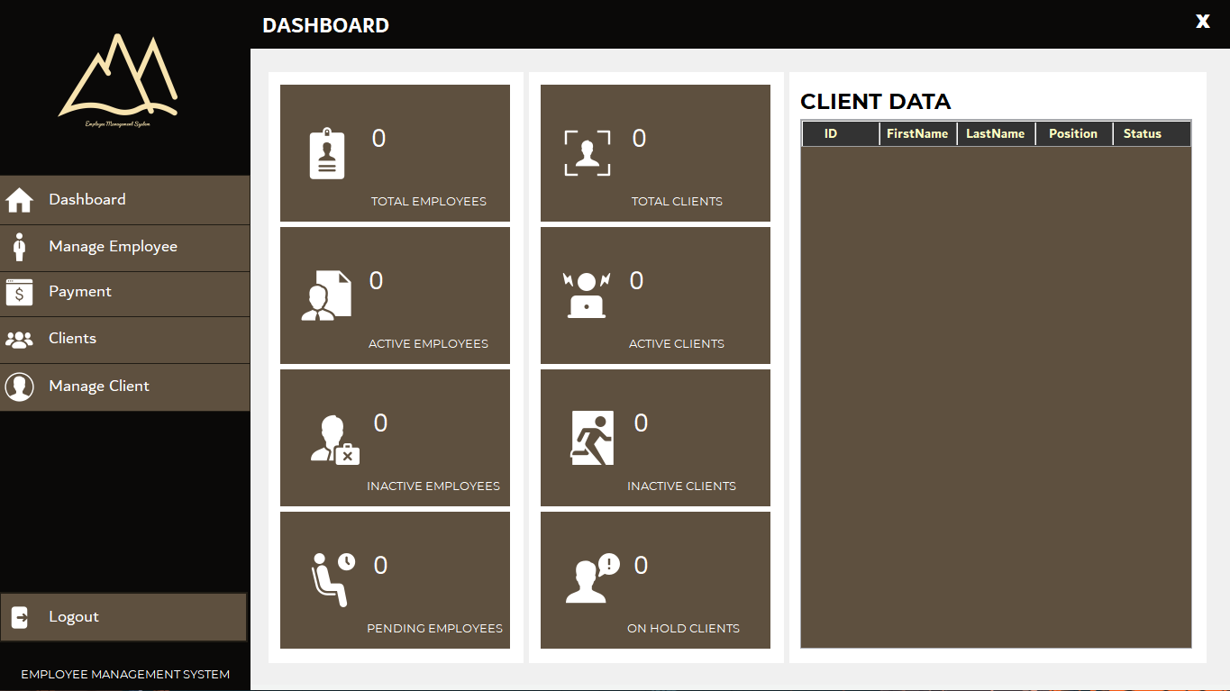
Requirements to run
StaffMaster:
- A PC Capable of installing windows

Slide 5

k
Technology Used To Create StaffMaster:
Platform: Windows
IDE: Visual Studio 2022
Language Used: C#, SQL

Slide 6

THANK YOU
LET’S NOW PROCEED TO THE DEMONSTRATION

